Slide 1
IN-SPACe Web Application Development IN-SPACe (Indian National Space Promotion and Authorization Centre) Remote |6 months
ANSEL CYRIL PAUL (23122107), MSc Data Science
Under the Guidance of
MR GAURAV KUMAR, IN-SPACe (Indian National Space Promotion and Authorization Centre) & Ms Margaret Salve Joseph, School of Sciences, Christ University, Pune Lavasa Campus
Conducted as part of the partial fulfilment of the requirements of Semester VI, MSc DS

Slide 2
ABOUT THE INTERNSHIP
Company Name: IN-SPACe (Indian National Space Promotion and Authorization Centre)
Domain: FULL STACK WEB DEVELOPMENT
Start Date: 5th DEC 2025
Website: https://www.inspace.gov.in/inspace
Mode: Remote
Stipend: Unpaid
Project Name: IN-SPACe Web Application Development

Slide 3
ABOUT IN-SPACe
Indian National Space Promotion and Authorization Centre (IN-SPACe)
Nodal agency under Department of Space (DOS)
Primary Function: Facilitates and regulates private sector participation in India's space activities
Key Areas: Satellite development, launch vehicle construction, space-based services
Strategic Role: Bridge between ISRO and private entities to accelerate India's space economy

Slide 4
INTERNSHIP OVERVIEW
Duration: 5th December 2024 to 31st May 2025
Role: Full Stack Web Developer Intern
Work Mode: Remote
Primary Technologies: Flask, PostgreSQL, RESTful API development
Main Responsibilities:
Database design and optimization
API development and testing
Form validation and processing
Backend integration with frontend systems

Slide 5
ASSIGNED PROJECTS & RESPONSIBILITIES
Database Architecture Development
Designing scalable PostgreSQL schemas
Implementing indexing strategies for performance optimization
API Infrastructure Development
Creating RESTful endpoints for frontend-backend communication
Implementing authentication and data validation
Form Processing System
Developing data validation mechanisms
Creating secure data storage workflows

Slide 6
WORK COMPLETED: FEBRAURY 15 – MARCH 14
Database Management
Designed and fine-tuned PostgreSQL databases to improve efficiency
Optimized queries and improved database structures to reduce latency
Implemented advanced indexing strategies for faster data retrieval
Refined database models to ensure data integrity and consistency

Slide 7
API Development
Built and tested RESTful APIs for frontend-backend communication
Implemented proper error handling and response formatting
Created comprehensive API documentation for team reference
Optimized API endpoints for improved performance
Forms and Models Development
Developed robust database models using Flask-SQLAlchemy
Implemented and refined various forms for improved data collection
Created comprehensive validation mechanisms for user inputs
Ensured secure data handling and storage protocols

Slide 8
Chat Interface: Developed real-time messaging system using WebSockets
Admin Panel Enhancements: Added new functionalities for better system management
User management features
System configuration controls
Data logging and monitoring tools
Debugging & Performance Optimization: Resolved issues related to:
Form handling
Chat response delays
Admin panel accessibility

Slide 9
FEEDBACK & FUTURE PLANS
Upcoming Deadlines
Complete chat functionality expansion
Finalize admin panel enhancements
Implement advanced form validations
Future Tasks
Expand Chat Functionality:
Message history implementation
User typing indicators
Notification alerts
Enhance Admin Panel:
Role-based access control
Analytics visualization
Content moderation tools
Improve Form Validations:
Stricter input validations
Enhanced error handling

Slide 10
LEARNING OUTCOMES & INDUSTRY EXPERIENCE
Technical Skills Gained
PostgreSQL performance optimization techniques
Flask application architecture best practices
WebSocket implementation for real-time communication
Admin panel development and management
Efficient form handling and validation
Industry Insights
Understanding of space sector regulatory requirements
Experience with enterprise-scale database management
Knowledge of software development lifecycle in government agencies
Importance of robust admin systems in large applications

Slide 11
CHALLENGES & OPPORTUNITIES
Challenges Overcome
Managing complex database relationships
Implementing reliable real-time communication
Ensuring security compliance for sensitive data
Optimizing performance for large datasets
Growth Opportunities
Further specialization in backend security
Advanced real-time communication systems
Database architecture optimization
Project management skills development

Slide 12
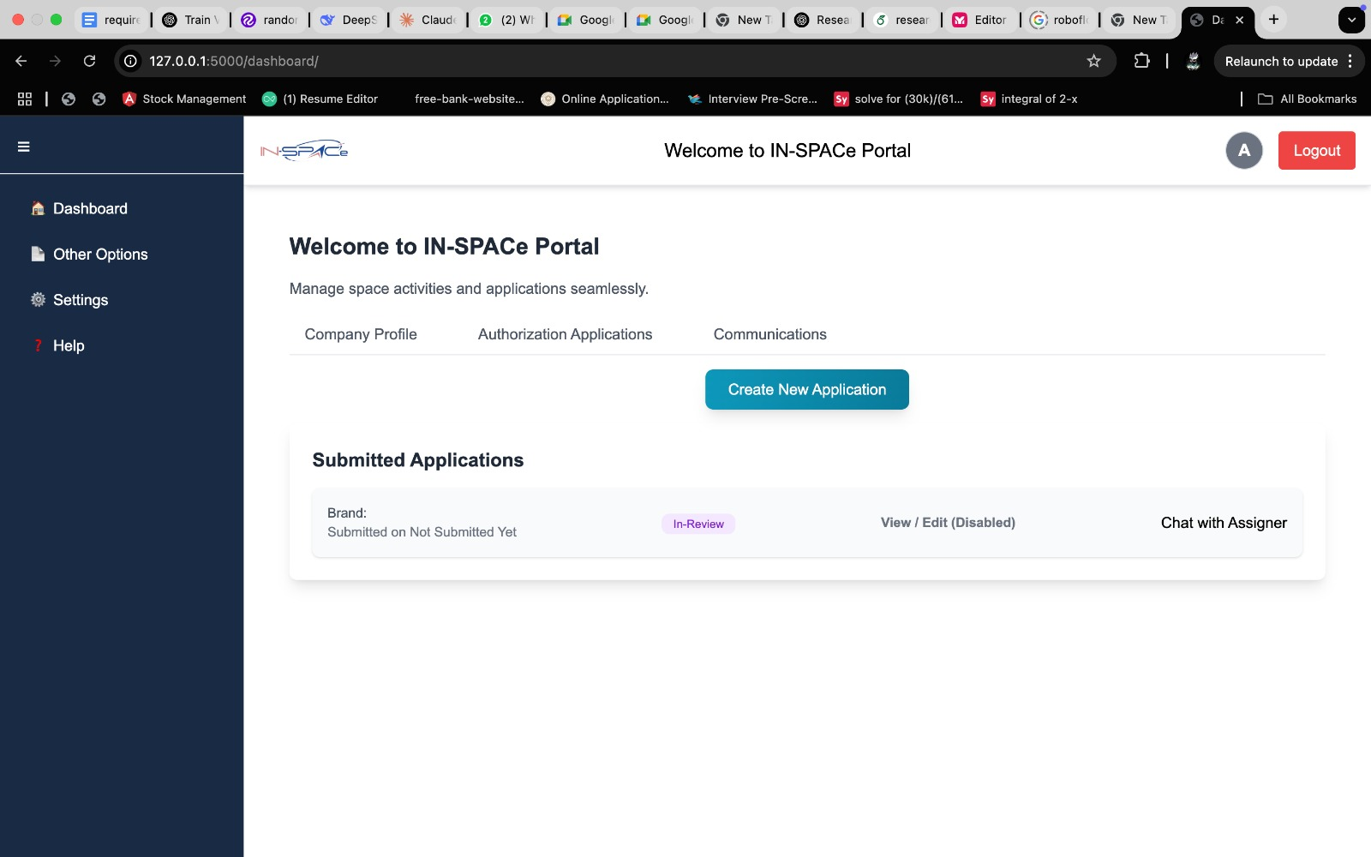
DEMONSTRATION

Slide 13
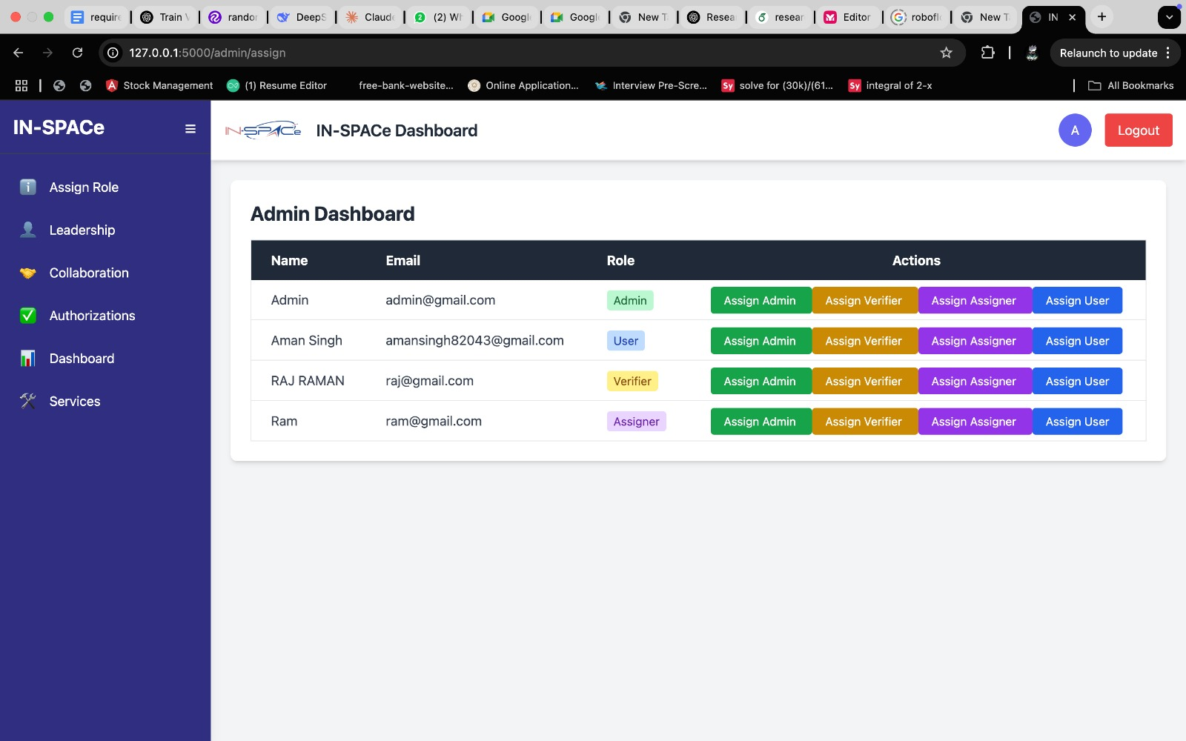

Slide 14
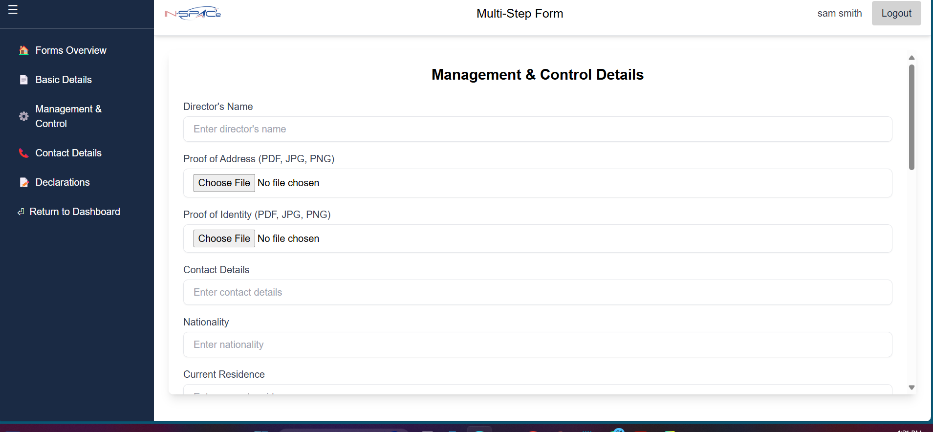

Slide 15
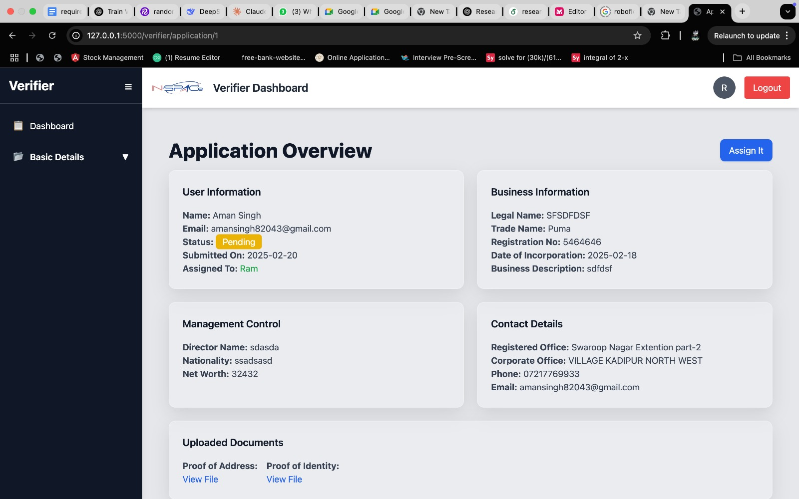

Slide 16
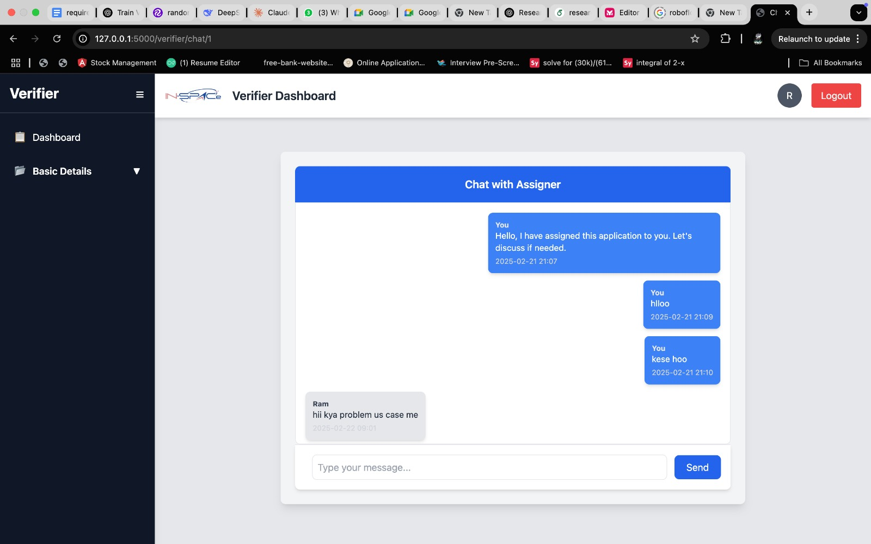

Slide 17
REFERENCES
Bayer, M. (2024). Flask web development with Python. O'Reilly Media.
Department of Space, Government of India. (2023). IN-SPACe: Regulations for private sector participation in space activities. https://www.inspace.gov.in/regulations
Eisenberg, A., & Melton, J. (2023). Understanding PostgreSQL performance optimization. Database Systems Journal, 14(2), 45-63.
Indian National Space Promotion and Authorization Centre. (2024). Annual report 2023-2024. IN-SPACe Publications.
Karnik, A. (2023). WebSocket programming for real-time applications. IEEE Software Engineering, 40(2), 88-99.
Momjian, B. (2023). PostgreSQL 14 administration cookbook. Packt Publishing.
Ronacher, A. (2023). Flask documentation (Version 2.3). https://flask.palletsprojects.com/

